Slide 1
How to use Nextcloud
Nextcloud is a private NAFE groupware service

Slide 2
Member login vs. Admin login
Use an alternate browser when using your admin login, so it does not get confused with your regular member login.

Slide 3
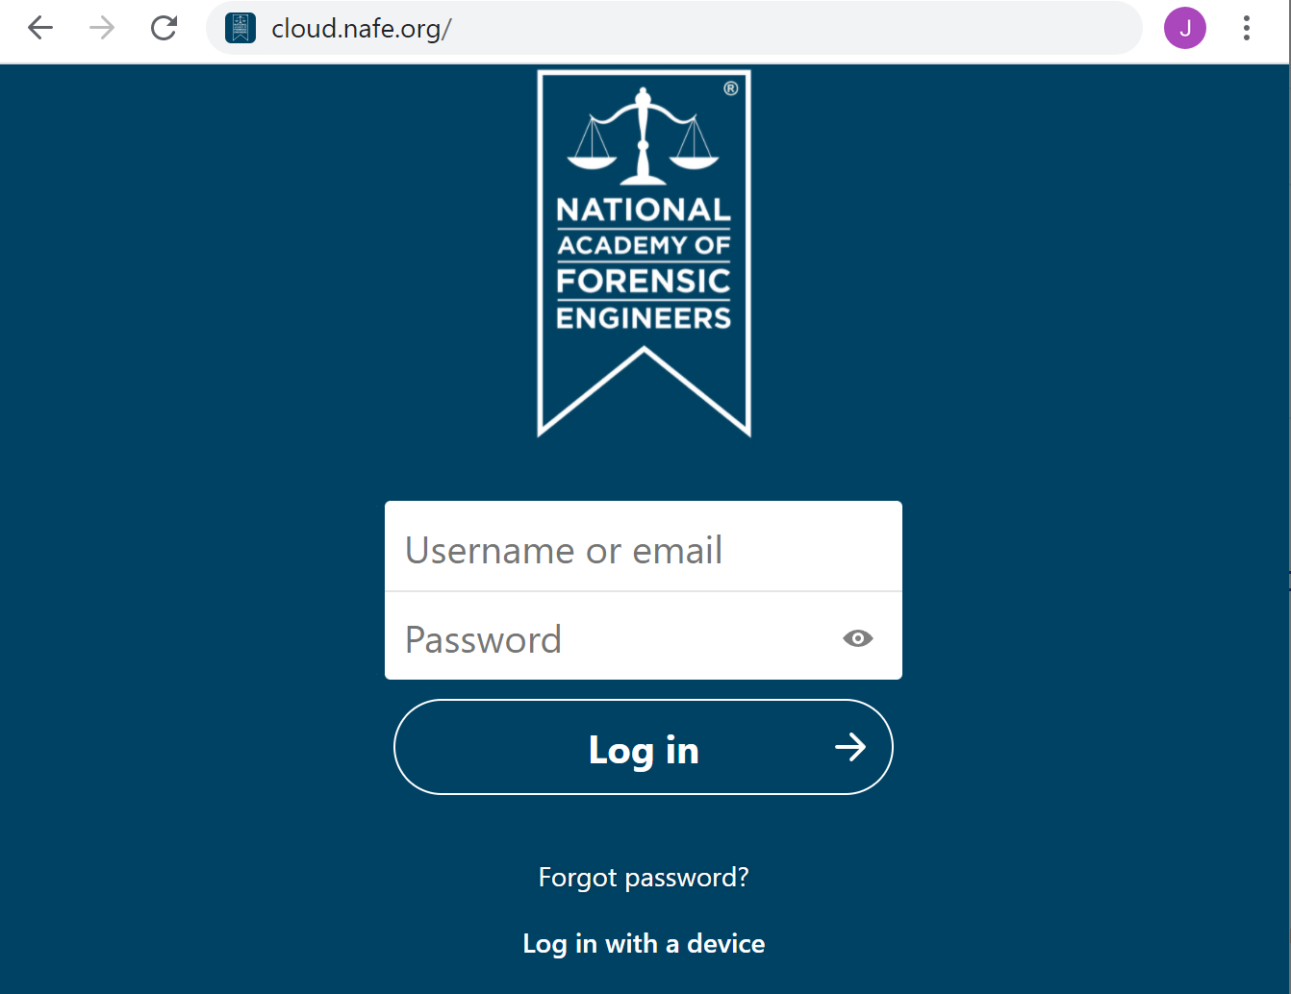
cloud.nafe.org
Use your admin login to access the NAFE cloud

Slide 4
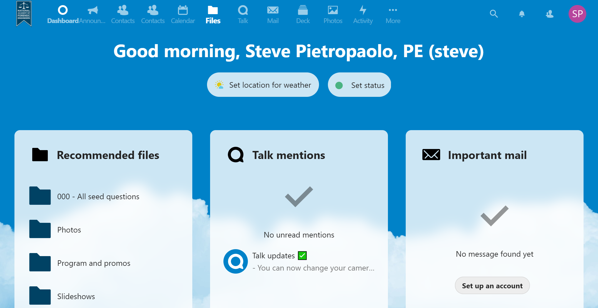
Go to Files

Slide 5
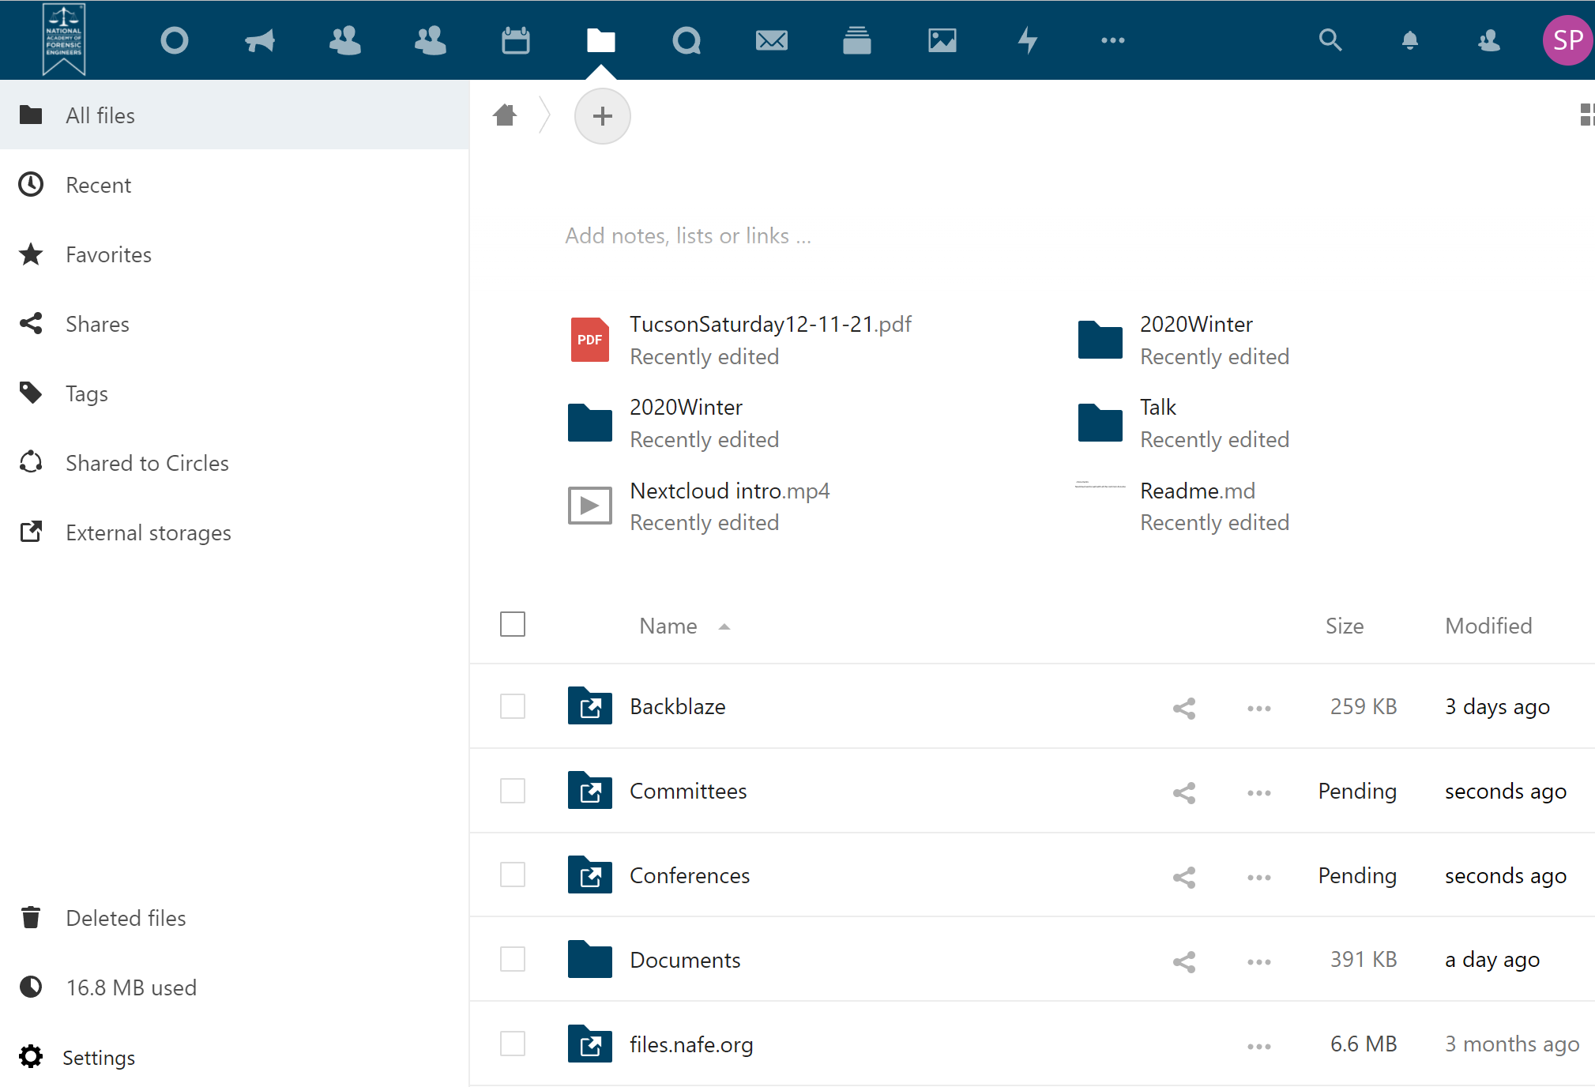
Find the appropriate folder

Slide 6
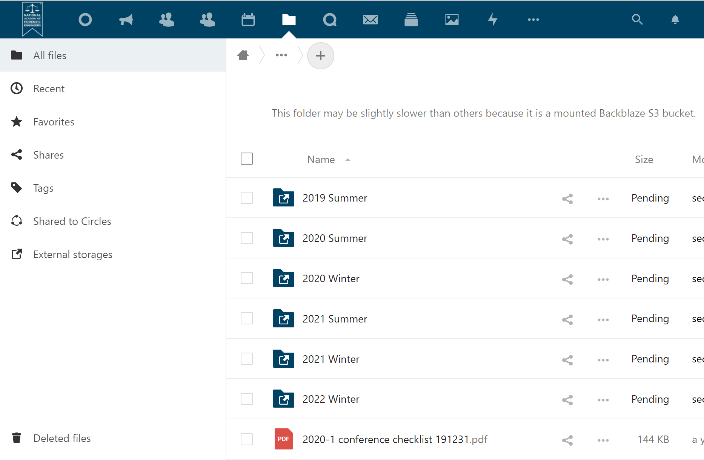
Find the appropriate sub-folder

Slide 7
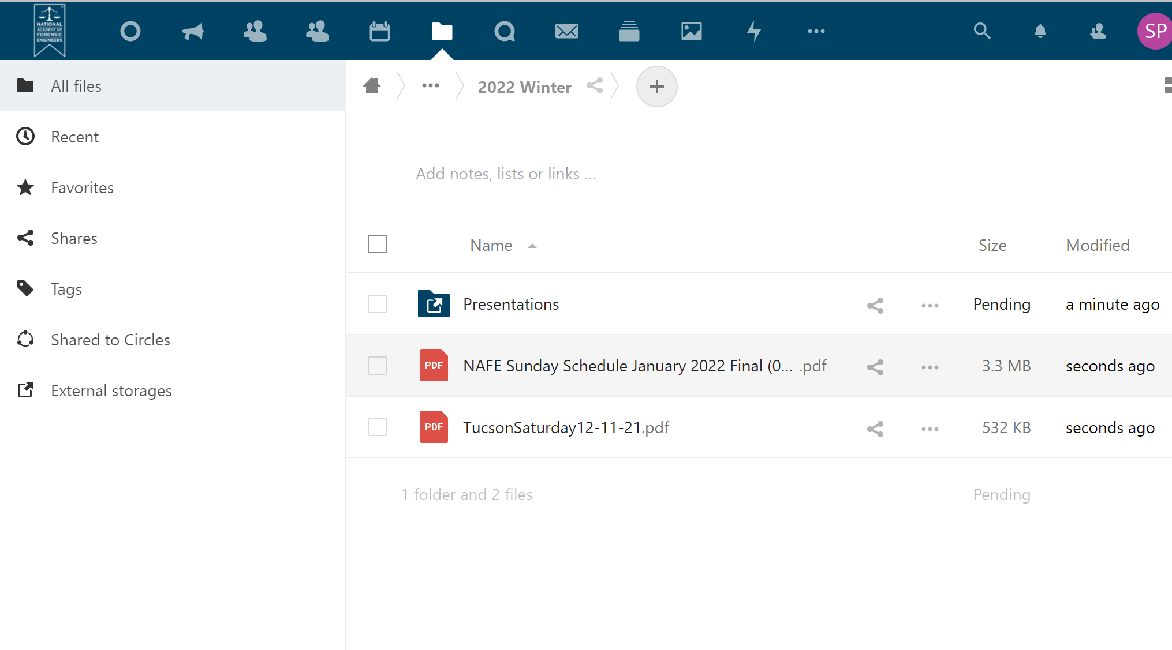
Uploading files – Drag and drop

Slide 8
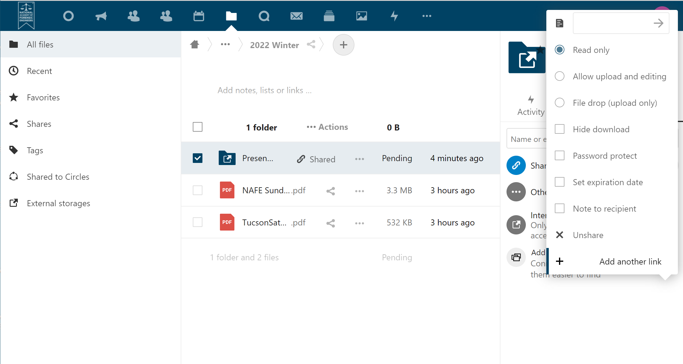
To allow non-users to upload a file, select a folder, select Share, then set the folder to "File drop".

Slide 9
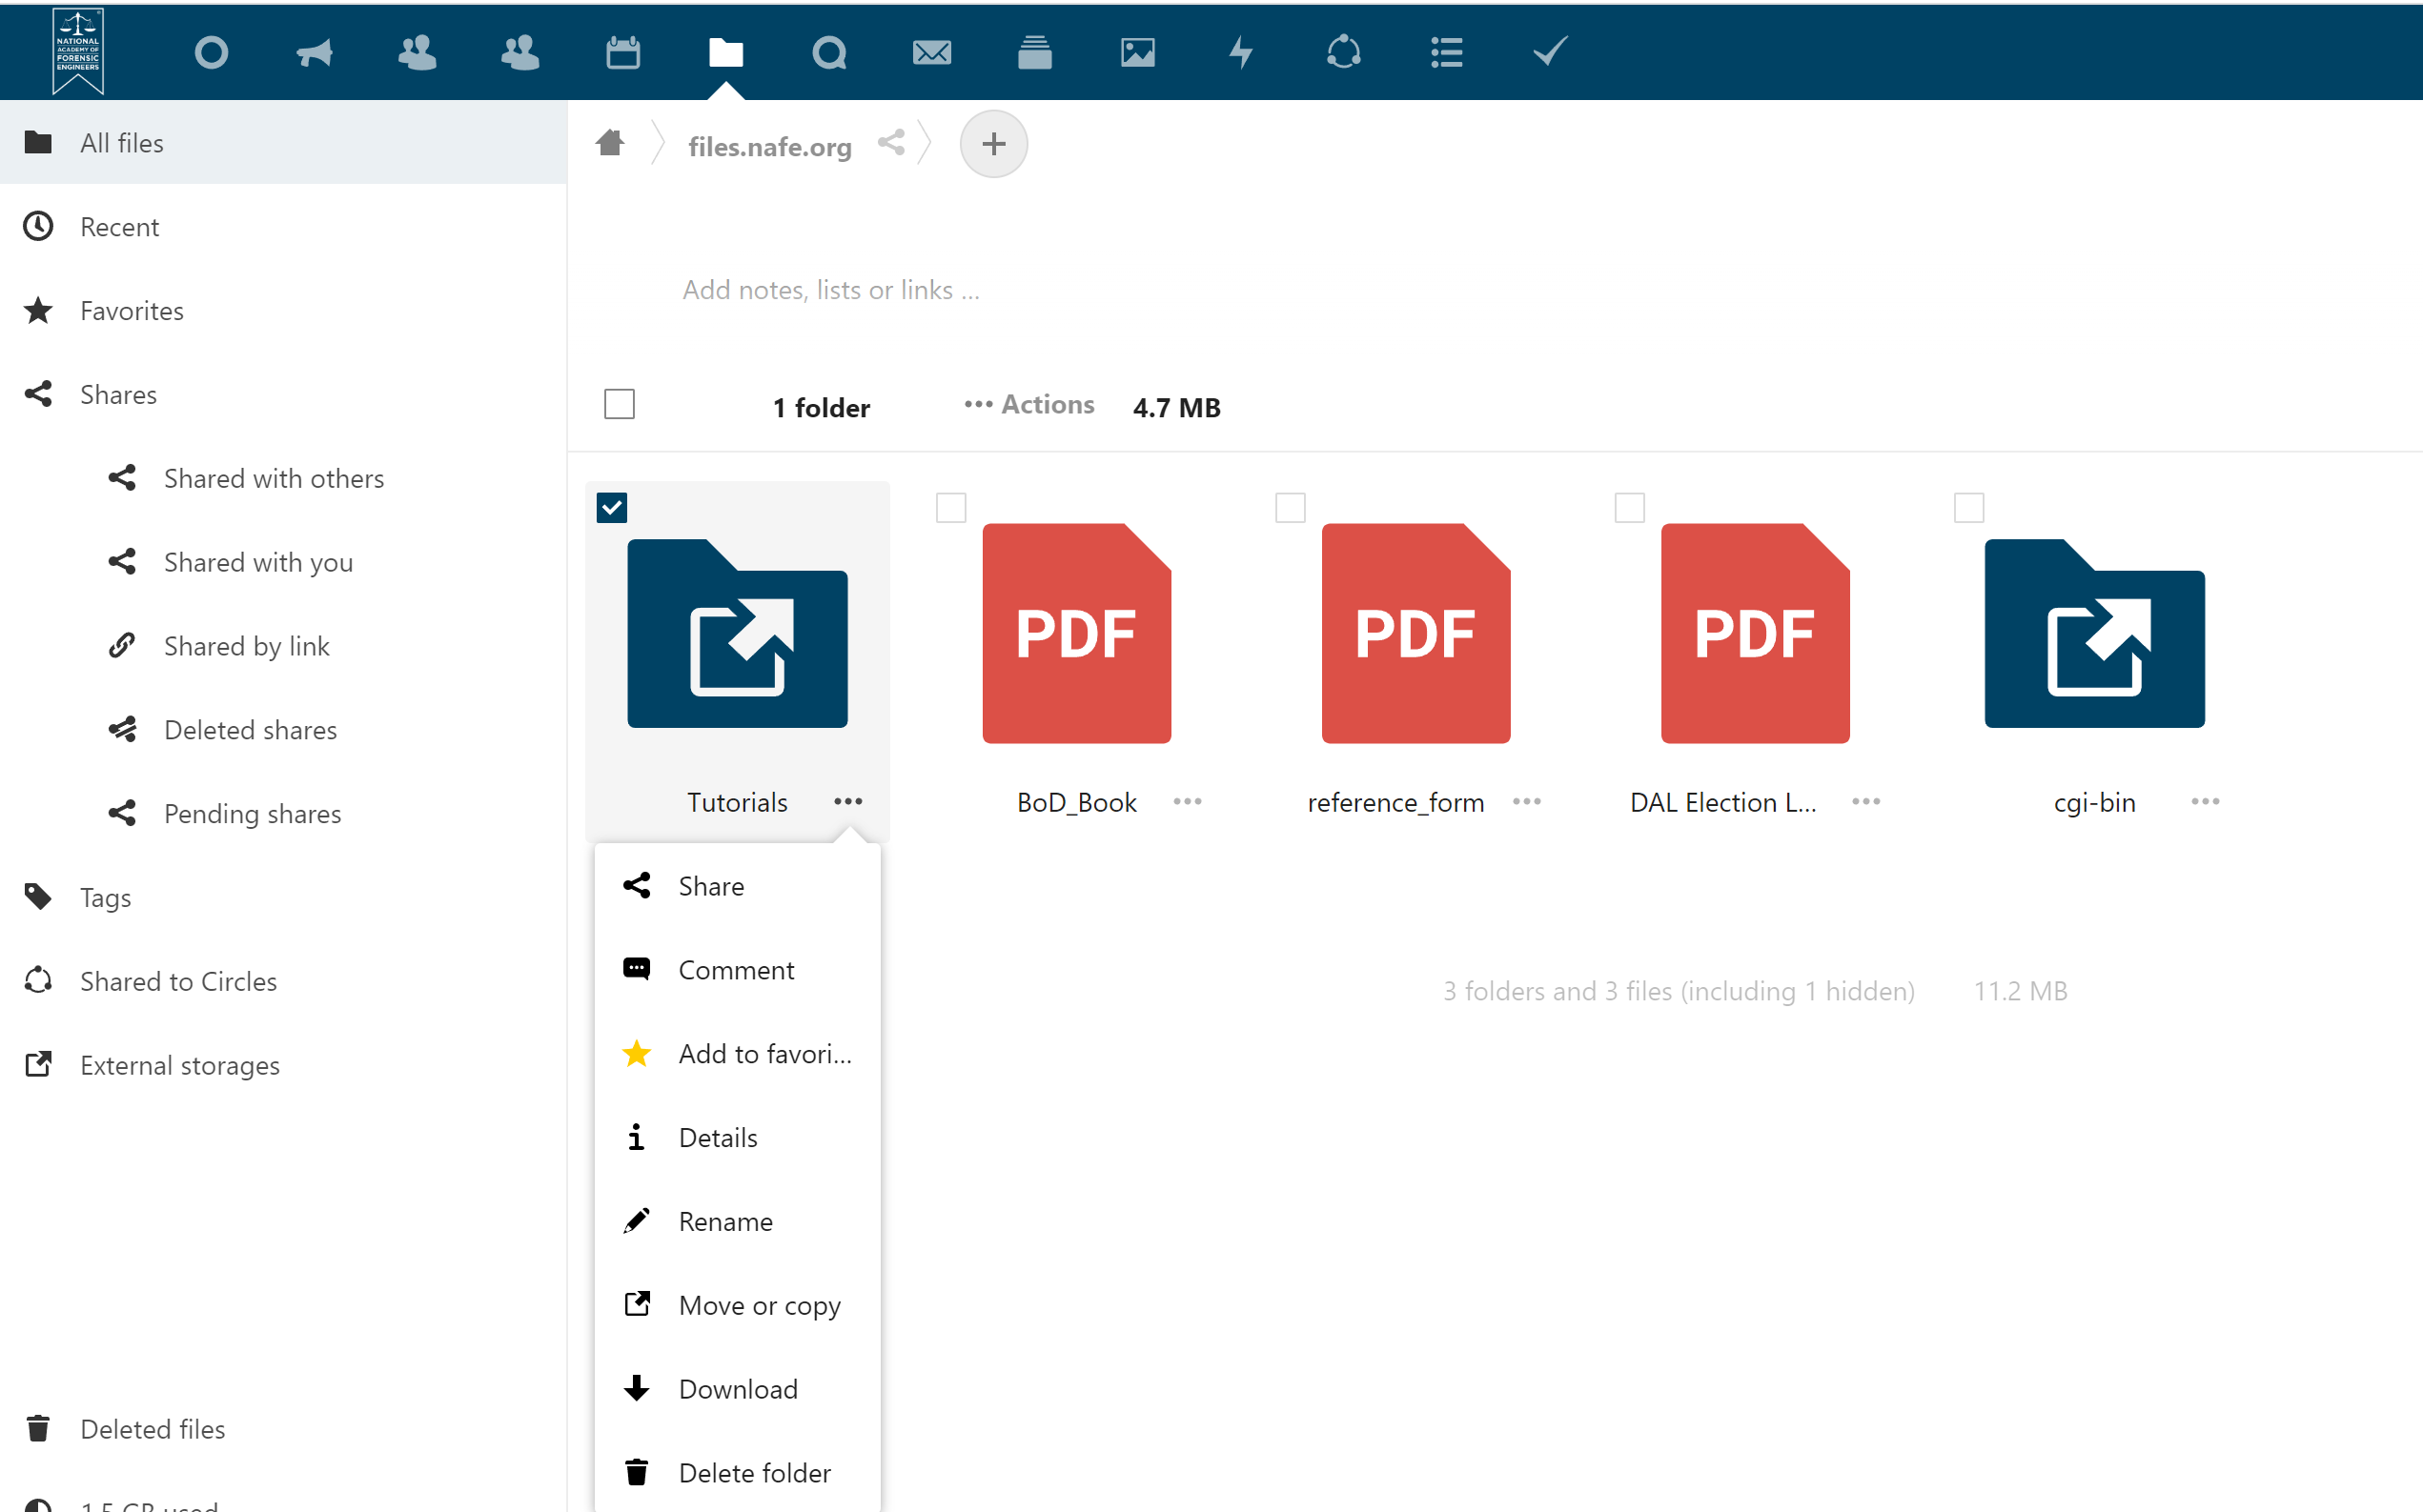
Sharing files

Slide 10
To distribute files – Create a share link

